Slide 1
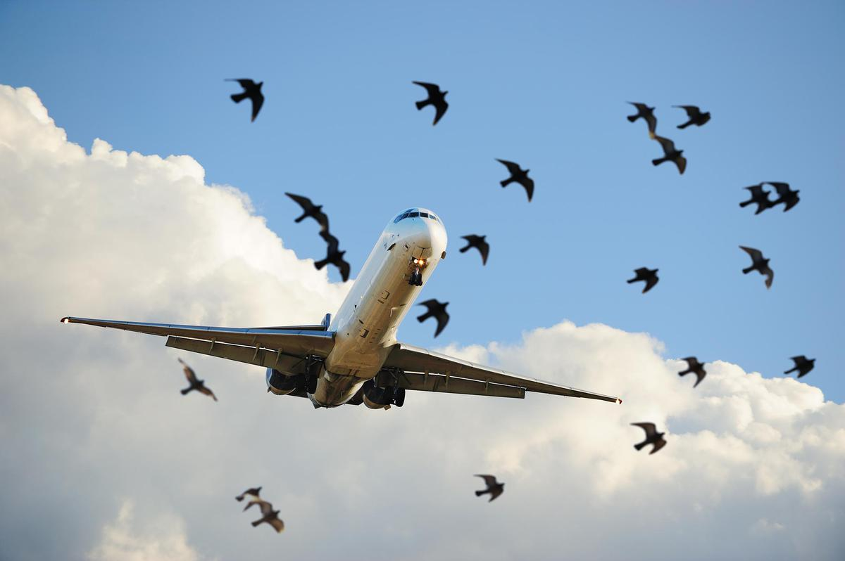

Bird Strikes Analysis Report
PRESENTED BY – SUSMITA KHANRA
DATE – 6 AUGUST 2024

Slide 2
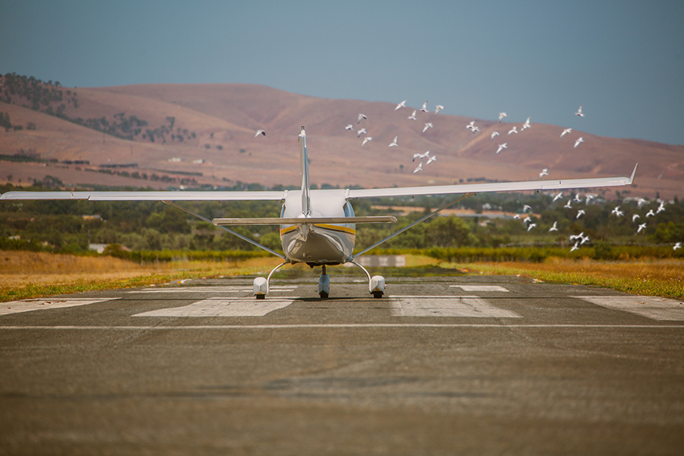
Agenda
Introduction
Problem Statement
Process
Dashboard
Insights
Summary

Slide 3

Introduction
Bird strikes, or collisions between birds and airplanes, present significant safety and economic challenges in aviation. These incidents occur when birds intersect with aircraft, particularly during takeoff, landing, or while in flight. The risks associated with bird strikes include potential damage to aircraft, which can lead to engine failure or structural harm, and pose safety hazards to passengers and crew. There are over 13,000 bird strikes annually in the US alone. The majority of the bird strikes (65%) cause little damage to the aircraft. To mitigate these risks, airports implement various control measures such as habitat management, deterrents like noise devices or lasers, and monitoring systems to track bird activity. Aircraft design and maintenance also play crucial roles in managing the impact of bird strikes, with ongoing research and technological advancements contributing to improved prevention strategies. Balancing safety with environmental concerns remains a key challenge in addressing bird strikes effectively.

Slide 4
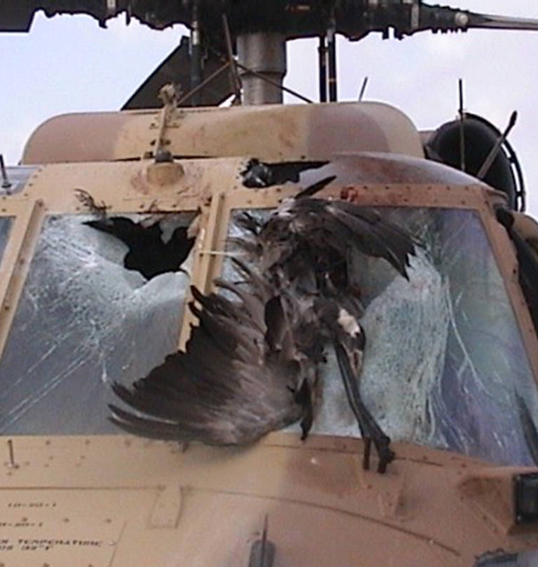
Problem Statement
Transport and communication are in the crucial domain in the field of analytics. Environmental impacts and safety are, nowadays, two major concerns of the scientific community with respect to transport scenarios and to the ever-growing urban areas.
These issues gain more importance due to the increasing amount of vehicles and people. Seeking new solutions is reaching a point where available technologies and artificial intelligence, especially MAS, are being recognized as ways to cope with and tackle these kinds of problems in a distributed and more appropriate way.
Bird strikes may occur during any phase of flight, but are most likely during the take-off, initial climb, approach and landing phases due to the greater numbers of birds in flight at lower levels. To have a closer look the following document visually depicts the data collected on Bird Strikes by FAA between 2000-2011.

Slide 5
Process
DATA
ANALYSIS
DATA
CLEANING
UNCOVERING
INSIGHTS
DATA UNDERSTANDING

Slide 6
Dashboard and Insights

Slide 7

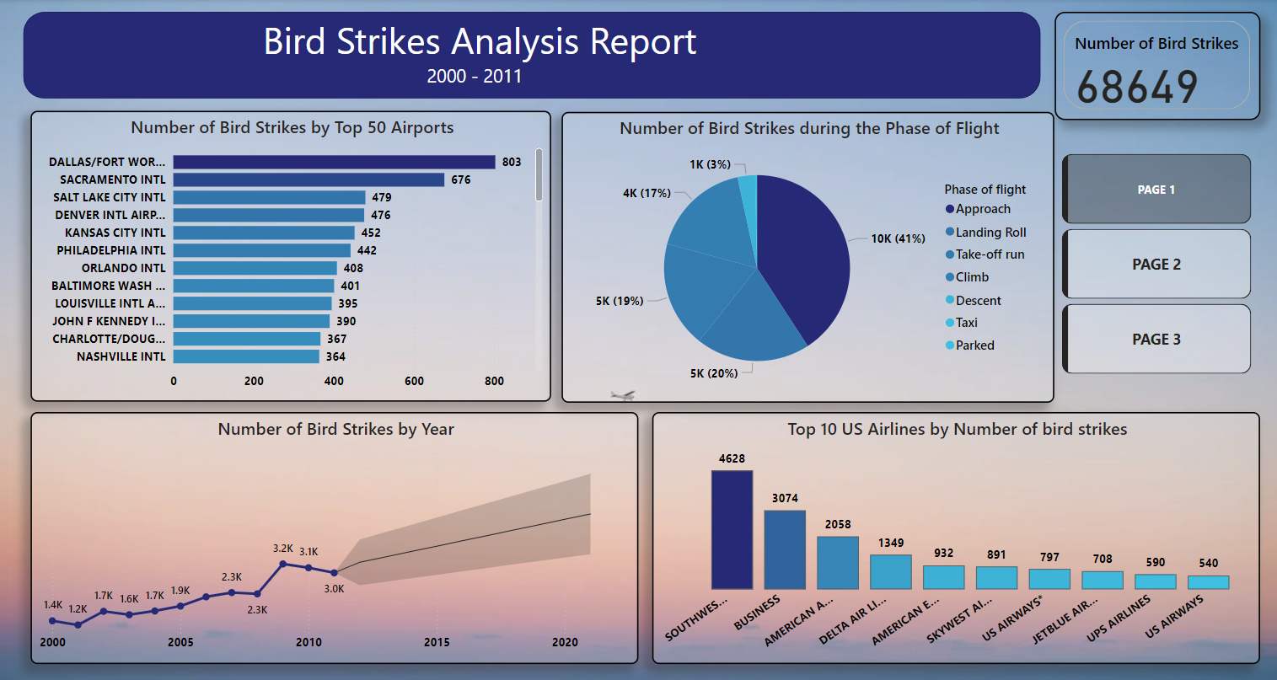
CRAIG MAPP

Slide 8
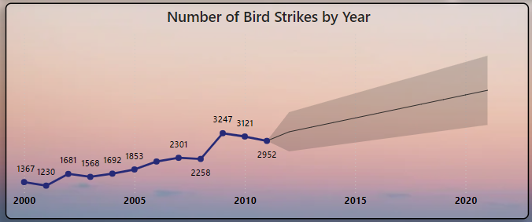

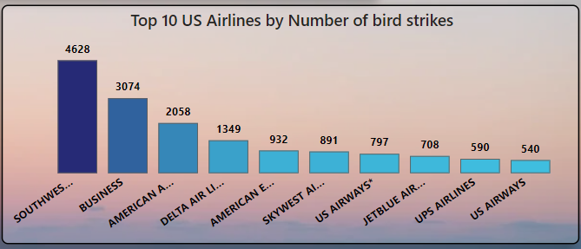
Insights
Total Bird Strikes (2000-2011): 68,649 reported by the FAA.
Trend: There was a significant increase in bird strikes starting in 2009, with the numbers rising every year thereafter.
Year with Highest Incidence: 2009 had a notably large number of bird strikes.
Top 10 Airlines by Bird Strikes: Southwest, Business, American, Delta, American Eagle, SkyWest, JetBlue, UPS, US are the Top10 Us Airlines by the number of bird strikes happened.

Slide 9
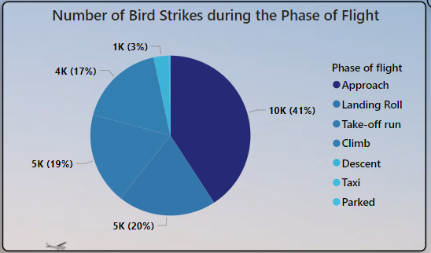
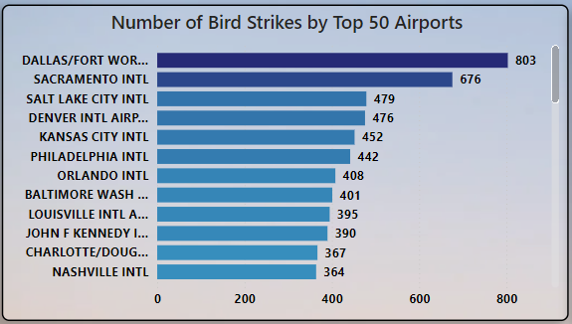
Insights
Total Bird Strikes (2000-2011): 68,649 incidents recorded by the FAA.
Bird Strikes During Approach: 41% of these strikes occurred during the approach phase of flight.
Bird Strikes During Landing and Takeoff: 5% occurred during landing and takeoff runs.
Top Airports for Bird Strikes:
Dallas/Fort Worth International Airport
Sacramento International Airport
Denver International Airport
Various other airports also experience high rates of bird strikes, making up the top 50 list.

Slide 10
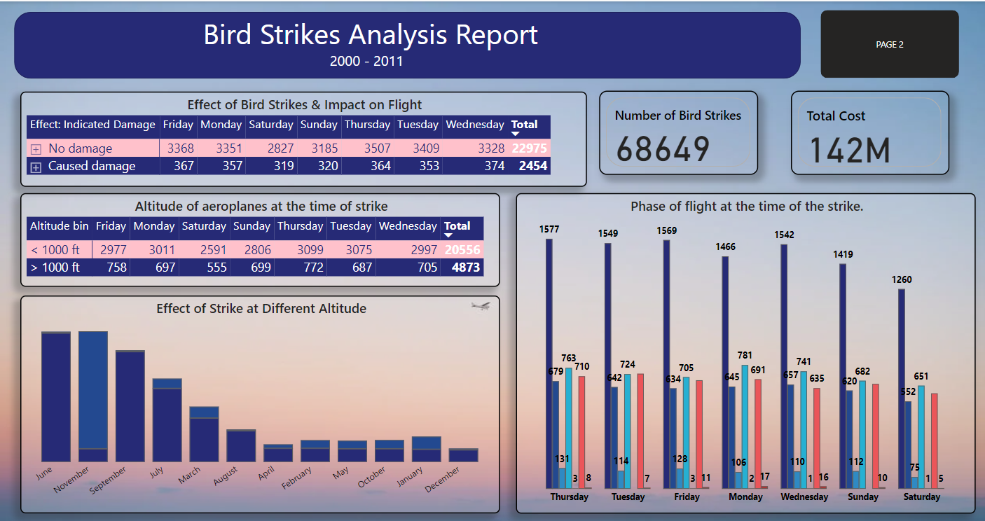
CRAIG MAPP

Slide 11
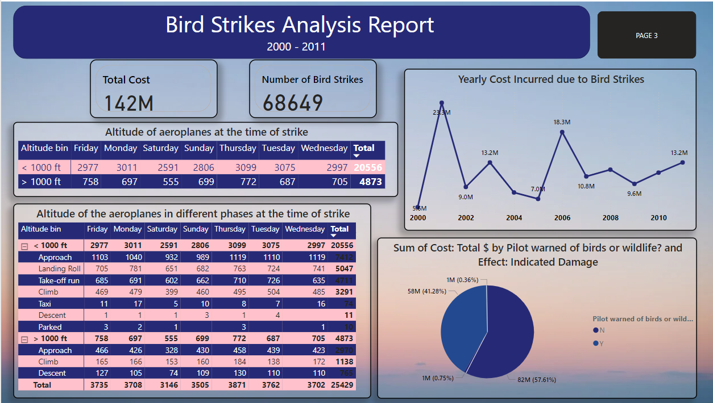
CRAIG MAPP

Slide 12
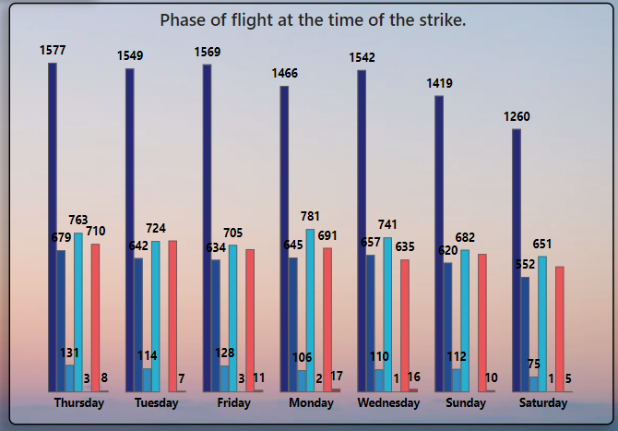
Insights
Weekly Peak in Bird Strikes: During the flying situation most of the bird strikes (1543) happened in a week. We can conclude that strikes occurred on business days
Altitude and Bird Strikes: On Monday, Tuesday and Thursday highest number of Brid Strikes happened. The majority of bird strikes (20,556) happened when the aircraft was below 1,000 feet in altitude.
Weekly Peak in Bird Strikes:We can conclude that strikes occurred on business days
Seasonal Patterns: Most of the strikes occurred on the summer season in the month of June (942) and September (806).
Day-Specific Flight Phases: On Thursday during approach (1577) and landing roll (763) phase of the flight Bird Strikes happened.

Slide 13
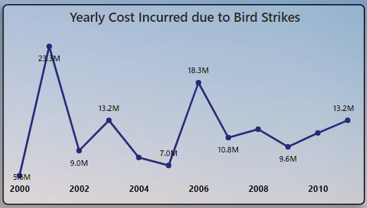
Insights
The high cost of $23.3 million in 2001 due to bird strikes was driven by extensive aircraft damage requiring expensive repairs, operational disruptions leading to delays and compensation, increased insurance premiums, and investments in bird control systems. These factors combined to significantly elevate the financial impact that year.
CRAIG MAPP

Slide 14
Preventive Measures
Preventive measures for bird strikes involve a multifaceted approach to minimize their impact on aviation.
Habitat management is crucial, including modifying airport landscapes to reduce bird attraction by managing vegetation and removing food sources.
Technological solutions play a key role, such as using bird detection radar systems for real-time tracking and deploying deterrents like sonic devices and visual repellents to keep birds away.
Wildlife management programs involve employing specialized teams to actively control bird populations and conducting regular monitoring to adapt strategies as needed.
Compliance with regulations and best practices, including FAA guidelines and staff training, ensures effective bird strike prevention. Lastly, collaborating with experts and investing in ongoing research helps develop and implement innovative strategies for mitigating bird strikes.

Slide 15
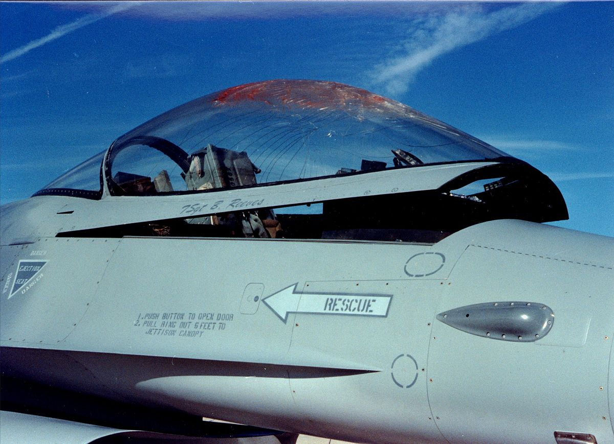
Summary
There was a significant increase in bird strikes starting in 2009, with the numbers rising every year thereafter.
It has been seen that on business days most accidents happened.
In 2001 highest cost was incurred due to Bird Strikes, it happens when flight is in landing roll and approach.
While complete prevention is challenging, ongoing efforts and technological advancements continue to enhance aviation safety and reduce the impact of bird strikes.

Slide 16

Thank You
Email ID – khanrasusmita02@gmail.com
LOOKING FOR WORK OPPORTUNITIES

